Slide 1
Harnessing Artificial Intelligence for Predicting Public Health Impacts Using EpiMaps
Predicting Local Health Outcomes
Oct 2023

Slide 2
What is epimaps?
EpiMaps is a flexible and scalable advanced analytic platform with a user-friendly visual interface to solve complex challenges in population health and wellness
Population Management: Inform decisions based on community needs
Program Evaluation: Uses most up-to-date data to understand efficacy
Resource Optimization: Deploy resources efficiently to maximize impact
Policy Improvement: Build better solutions for the future
Booz Allen’s Data Lake
Your Proprietary Data
Technical Solutions
32 data sets with 125,640 unique data points
Public health and socioeconomic health data
Mission-focused metrics
Seamlessly integrated proprietary and public data
Interactive visualization
Custom user interface
Machine learning
Robotic process automation
Notes:
Click to play

Slide 3
EpiMaps Use Cases
Readiness Prediction Model
Built utilizing historic Army data, being operationalized for Joint use
Quantifiably define individual readiness
Predict and report the level of deployability DoD may achieve
Identify the root causes of non-deployability
Suicide Prevention and Readiness in the National Guard
Developed with the National Guard J1
Understanding of the risk and protective factors of the force by state
Identify the largest, most at-risk populations and leading health risk factors to inform resource allocation decisions
Air Force Strategic Basing
Deputy Assistant Secretary of the Airforce for Installations
Developed a defendable framework, criteria and methodology to incorporate public education and professional licensure portability factors into the Air Force process for basing decisions
Community Readiness-Open Data Dashboard
Developed in support of the Building Healthy Military Communities Pilot for the Undersecretary of Defense for Personnel & Readiness
Utilize health relate quality of life indicators to predict future health outcomes
Identify community health headwinds and use as a proxy for readiness

Slide 4
Community Readiness Model: Scientific Process
Define
Define study population
Data
Conduct literature review
Hypotheses & Business Rules
Define outcome variable
Obtain publicly available data as informed by the literature review
Establish hypotheses related to readiness proxy outcome
Establish business rules on how the data will be processed
Data Wrangling
Clean data & perform data checks to ensure data integrity
Conduct imputation techniques to handle missing data
Model and Evaluation
Run various models & interpret feature importance
Evaluate performance of each model type and consider strengths and weaknesses of each

Slide 5
Community Readiness: Service Member and Veteran Populations
Define
Deriving County-Level Estimates from Available Sources
Active and Reserve Populations:
Public Use Microdata Sample (PUMS) files from the 2016 American Community Survey
Next, added spatial translations and population density allocation factors from Missouri Census Data Center
Used to convert PUMAs to county-level data
Veterans Population:
United States Department of Veterans Affairs National Center for Veterans Analysis and Statistics
Used deterministic actuarial projection model developed by the office of Predictive Analytics and Actuary (PAA)
Helped predict age ranges, gender, and overall Veteran population.
Relied on both Veteran record‐level data and survey data from a wide variety of sources:
- Department of Defense, U.S. Census Bureau, Internal Revenue Service, Social Security

Slide 6
Community Readiness: Outcome Measures
Define
Constructing Readiness Measures from Community-Level Data
TFF uses Health Related Quality of Life (HRQoL) metrics as measured by the CDC’s Behavioral Risk Factor Surveillance System (BRFSS)*
HRQoL is a concept that incorporates principles of physical, mental, and emotional health domains
According to studies within the DoD, HRQoL measures have been shown to be associated with readiness
Three HRQoL measures were chosen to proxy readiness outcomes:
Physical health days (survey response - number of poor physical health days within last 30 days)
Mental health days (survey response - number of poor mental health days within last 30 days)
Overall health (survey response - % of adults within a county reporting poor or fair health)
*More information regarding BRFSS can be found at the CDC’s site - https://www.cdc.gov/brfss/annual_data/2018/pdf/overview-2018-508.pdf

Slide 7
Community Readiness: Data Sources
Data
Leveraging Existing Data from Multiple Agencies
The team gathered publicly available data from sources spanning the multiple domains of Total Force Fitness
This research identified health risk factors that were correlated with three proxy readiness outcomes
County-level data is the closest publicly available surrogate to DoD data on individual Service Members.
Criteria for inclusion:
Related to one of the 8 TFF domains
Available county-level data or a way to aggregate to the county-level
Current data within a three-year timeframe since 2012
Less than 25% missingness
Community readiness data source details:
23 unique datasets, 33 total features, 4 total outcome variables
Plan to capture historic data from 2010+ for upgrades & time series analysis

Slide 8
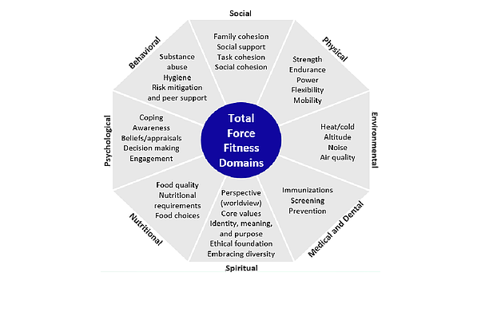
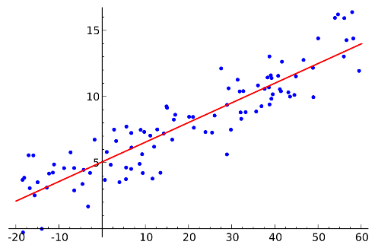
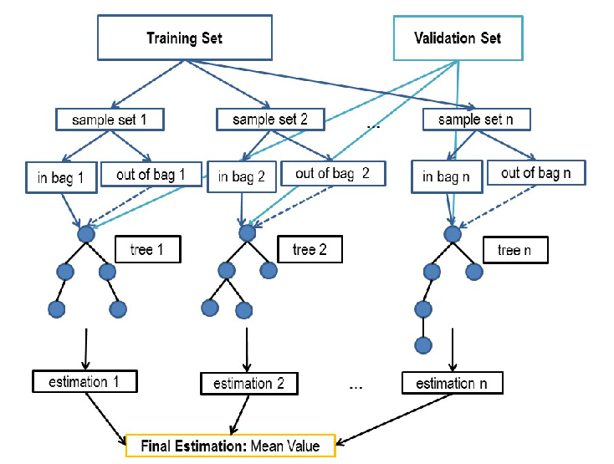
Community Readiness: Predicting HRQoL from County Risk Factors
Hypothesis & Business Rules
Overall, Physical, and Mental Health are Dependent Upon Measurable Community Factors
A regression task to model HRQoL such as the number of unhealthy days or percent of unhealthy adults
A model with high explanatory power can grant additional insight into the relationships among community health and risk factors
Also allows for calculations regarding how expected changes each risk factor may impact the predicted HRQoL
Hypotheses:
1) Holistic review of Service member’s physical and emotional well-being is necessary to accurately predict outcomes
2) Relationships among county readiness outcome and some county risk/protective factors are non-linear
Machine learning algorithms will outperform both traditional and generalized linear regressions
Hypothesis 1
Hypothesis 2
Linear Regression Model
Random Forest Model

Slide 9
Community Readiness: Dealing with Missing Data
Data Wrangling
Imputation by Proximity and Demographics
Missing data were imputed by one of two methods: Proximity or Demographic based
Method chosen dependent on specifics of each variable
Baltimore City and Baltimore County likely have very similar levels of air pollution – imputation by proximity
The same nearby counties have significant differences in crime rates, thus, imputations by demographics must be used
For proximity-based method, missing values of the specified variables were imputed using the data from the nearest county, based on population density
For a demographics-based method, a form of “k-means” clustering is used
First, missing values of the variables are imputed with the mean.
Next, the counties are grouped by similarities in the measures included. Missing values are then imputed with the average of the cluster for which the point belongs to.
The clustering is re-run until either the groupings remain unchanged or the maximum number of iterations is reached
Missing Values Imputed by Proximity | Missing Values Imputed by Demographics
Land Environment Quality Index | Premature Death
Water Environment Quality Index | Adult Smoking
Air Pollution (Particulate Matter) | Adult Obesity
Presence of Violation in Drinking Water | Physically Inactive
Food Environment Index | Access to Exercise Opportunities
Primary Care Physicians | Excessive Drinking
Dentists | Alcohol Impaired Driving Deaths
Mental Health Providers | Sexually Transmitted Infections
 | Uninsured
 | Healthcare Costs
 | Diabetes Prevalence
 | Unemployment
 | No High School Diploma
 | Bachelor’s Degree or Higher
 | Income Inequality
 | Violent Crime
 | Injury Deaths
 | Median Household Income
 | Injury Deaths
 | Severe Housing Problems
 | Long Commute
 | Opioid Prescribing Rate
 | Water Fluoridation Rate

Slide 10
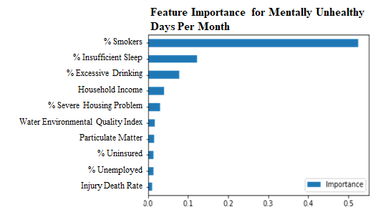
Community Readiness: Findings from HRQoL Modeling
Model & Evaluation
Comparing Performance of Potential Model Types
Model Comparison:
For all three outcome measures, the Random Forest (RF) regressor outperformed the best ElasticNet Generalized Linear Model Regression (GLM)
Models were evaluated using 5-fold cross-validated R-squared scores and by graphical analysis of residuals from predicted values
Feature Importance Analysis:
Models for all outcome measures identified the following predictors as discriminative for prediction:
% Smokers
Household income
% Insufficient sleep
% With no high school diploma
% With excessive drinking
HRQoL Outcome | RF R² | GLM R²
Overall Health | 0.895 | 0.887
Physical Health | 0.868 | 0.837
Mental Health | 0.837 | 0.766

Slide 11
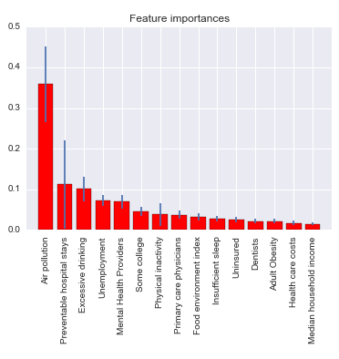
Community Readiness: Model Robustness Evaluation
Model & Evaluation
Testing Model Performance without Top Variables
After removing the top 3 explanatory variables:
R²: 0.77
Higher standard deviations
Model remains relatively robust despite losing top features
Suggests underlying factors could be present at the community level
Prompted a Principal Component Analysis (PCA)

Slide 12
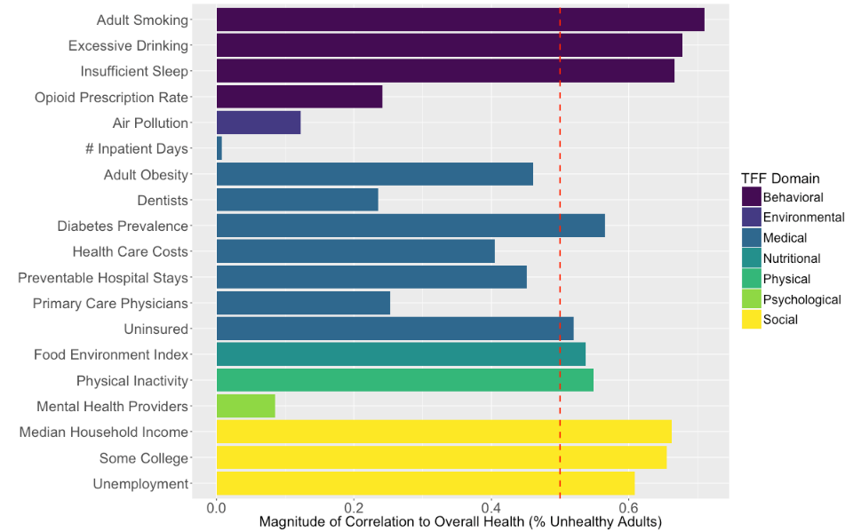
Community Readiness: Model Decomposition
Model & Evaluation
Exploring Relationships among Explanatory Variables and HRQoL Outcomes
Principal Component Analysis (PCA) was utilized to find the underlying explanatory component by normalizing all the measures and creating orthogonal components
First component accounts for most variability in data
Scree Plot

Slide 13
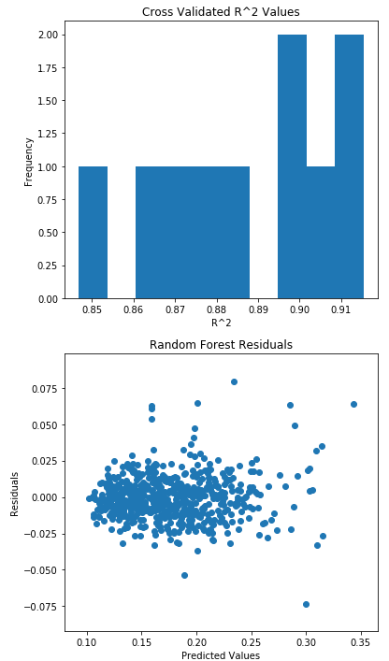
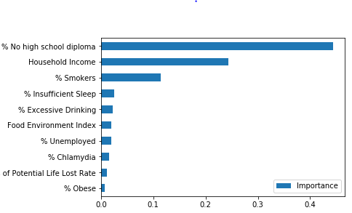
Community Readiness: Overall Health Modeling Robustness Check
Model & Evaluation
Evaluating and Interpreting Model Results
Model Performance
Top features for explanatory power (1+ std. dev from mean):
% No high school diploma (0.443701)
Household Income (0.243367)
These results align with the findings of the ElasticNet linear regression model
Feature Importances

Slide 14
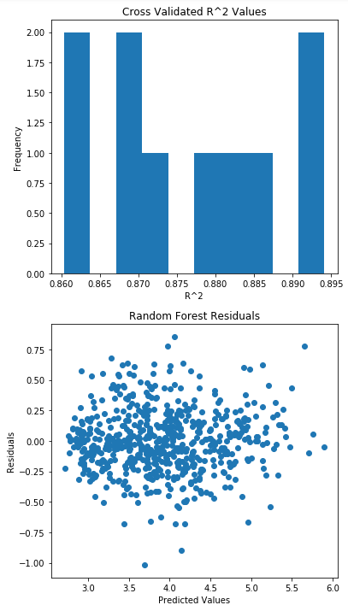
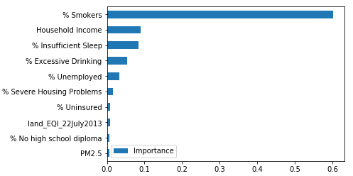
Community Readiness: Physical Heath Modeling Robustness Check
Model & Evaluation
Evaluating and Interpreting Model Results
Model Performance
% Smokers (0.603) is the largest feature importance by far, skewing the mean importance and standard deviation.
5 additional features were significantly above the median feature importance
Household Income
%Insufficient Sleep
Excessive Drinking
% Unemployed
% Severe Housing Problems
Feature Importances

Slide 15
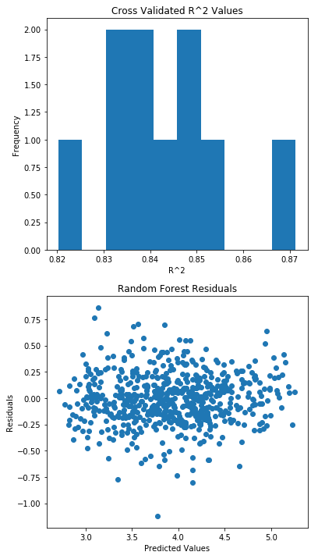
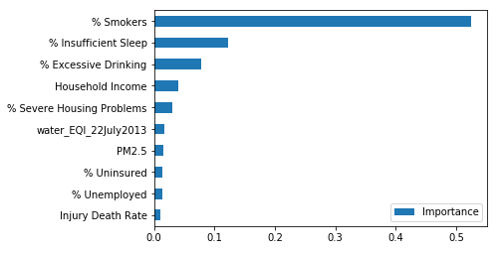
Community Readiness: Mental Health Modeling Robustness Check
Model & Evaluation
Evaluating and Interpreting Model Results
Model Performance
Top Features for Explanatory Power (1+ std. dev from mean):
% Smokers (0.602845) and
% Insufficient Sleep more than one standard deviation away from the mean.
Feature Importances

Slide 16
Questions?

